Slide 1
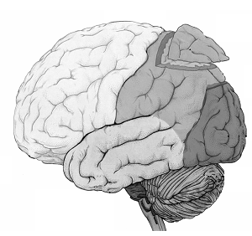


Principles of Dynamic Causal Modelling
(DCM)
Dr. Bernadette van Wijk

Slide 2


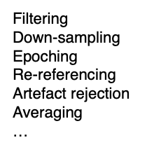
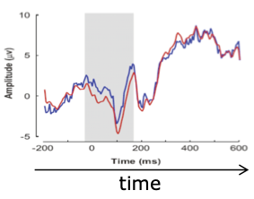
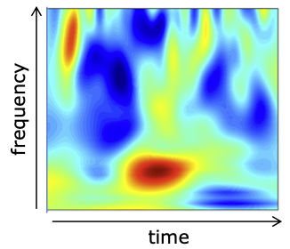
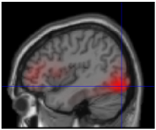
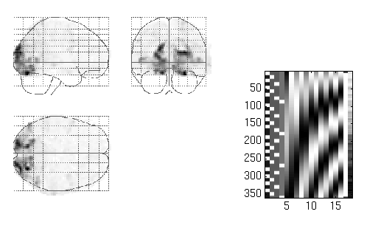
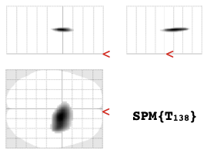
EEG/MEG data processing so far
Time or frequency-domain
1. Experimental design & data collection
2. Pre-processing
3. Feature extraction
GLM
4. Source localization
4/5. Statistical inference
6. Result!

Slide 3
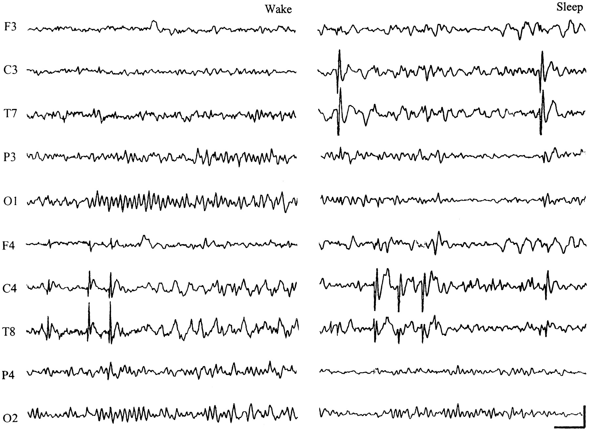
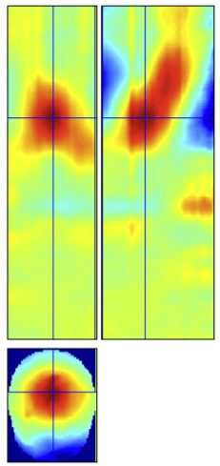
Generative mechanisms
The next challenge…
Observed data features
?
What is causing the observed data features?

Slide 4
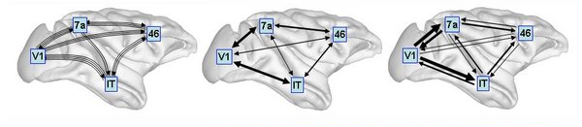
Structural connectivity
Functional connectivity
Effective connectivity
O. Sporns 2007, Scholarpedia
Structural connectivity = presence of axonal connections
Functional connectivity = statistical dependencies between regional time series
Effective connectivity = causal (directed) influences between neuronal populations

Slide 5
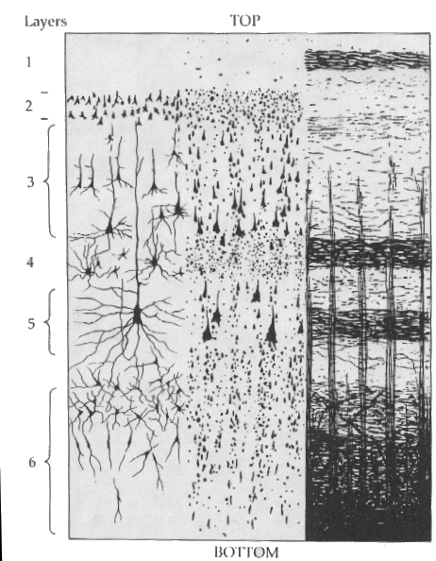
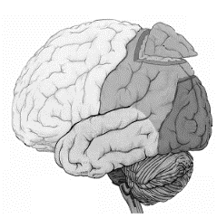
DCM estimates bio-physiological information from functional neuroimaging data
Network of brain regions
Individual neural populations
Inhibitory interneurons
Spiny stellate cells
Pyramidal cells
E.g. Bottom-up vs top-down connection strengths
E.g. Synaptic coupling strengths, membrane time constants

Slide 6
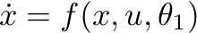
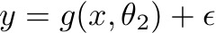
DCM is a computational modelling technique that relies on a generative model
Differential equations describe how brain activity is generated from (synaptic) input:
Equations may be quite simple or more biologically detailed
Model parameters represent (biological) information of interest
An observation function translates modelled brain activity to predicted measurements
Different types of generative models exist but the DCM principles are always the same!

Slide 7
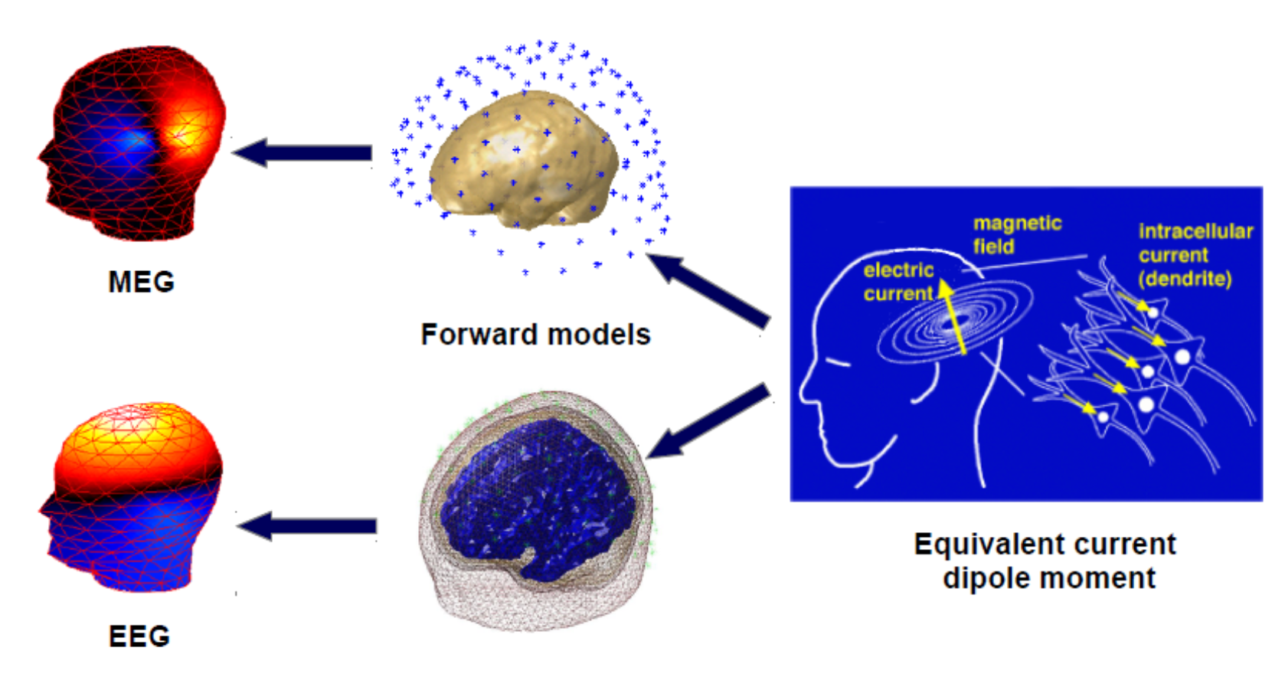
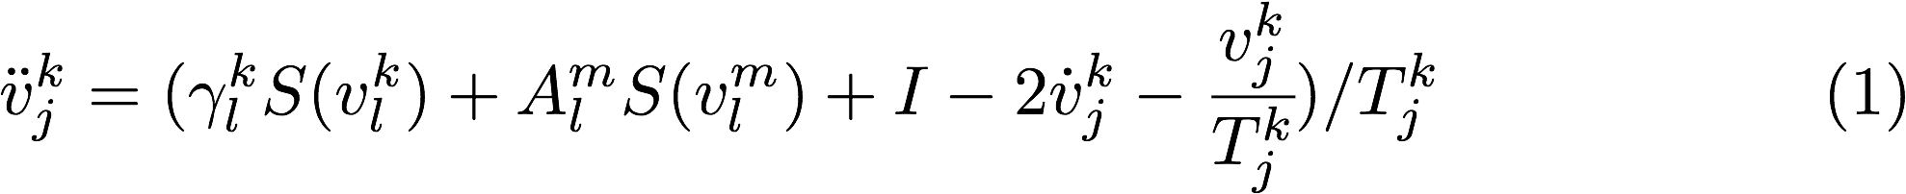
Generative models for EEG/MEG
Neural state equations
+
Observation function
Describe dynamics of brain activity
Maps brain activity to data features
General descriptions
Convolution based models (Jansen-Rit)
Conductance based models (Morris-Lecar)
Forward model / Lead field for EEG/MEG
Gain function for LFPs
(Feature extraction)
Membrane potential of cell population in source
Between-source synaptic coupling strengths
Within-source synaptic coupling strengths
External input
Time constant
Sigmoidal function translating pre-synaptic membrane potential into firing rate

Slide 8
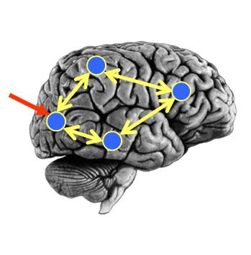
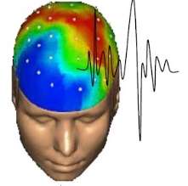
Causal mechanisms
Observed data features
y
Generative model
stimuli
u
Neural Model
Observation Model
θ
+
Forward model
Forward Modelling
Model Inversion
What brain activity does the model predict to occur for my parameter values?
Given our observations , and stimuli what parameters values make the model best fit the data?
y
u
θ

Slide 9
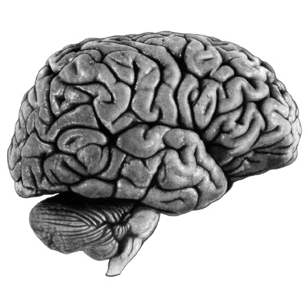
What can we do with DCM?
Model A
Model B
driving
input
driving
input
modulation
modulation
Model comparisons Test hypotheses
Does model A explain the data better than model B?
Parameter inference What are the connection strengths?
How do they change between conditions?
Simulations What happens to neural activity if…

Slide 10
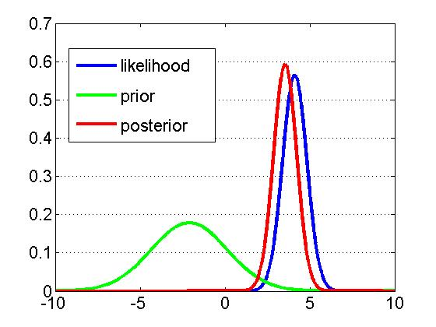
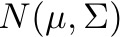
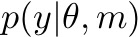
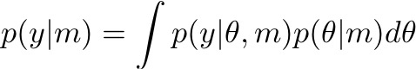
Bayesian Inference
DCM: model structure
Priors on all parameters
Neural state equations
Observation function
→ Likelihood
DCM: Bayesian inference (expectation-maximization)
Posterior parameter estimates
Model evidence
or ‘Free Energy’
“Accuracy - Complexity”

Slide 11
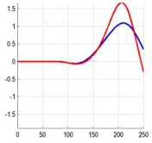
Model inversion
Specify generative forward model
(with prior distributions of parameters)
Data feature (e.g. evoked responses)
Expectation-Maximization algorithm
Compute model response using current set of parameters
Compare model response with data
Improve parameters, if possible
Observed
Iterative procedure:
Amplitude (a.u.)
Predicted
Time (ms)
Posterior distributions of parameters
Model evidence

Slide 12
After inversion
Check if model predictions of observed data are adequate
Test hypotheses by comparing model evidence
for an individual subject, within or between groups of subjects
Assess parameter estimates Individual values, group averages, significant differences between conditions or groups of subjects
→ Video: Bayesian model selection and averaging

Slide 13
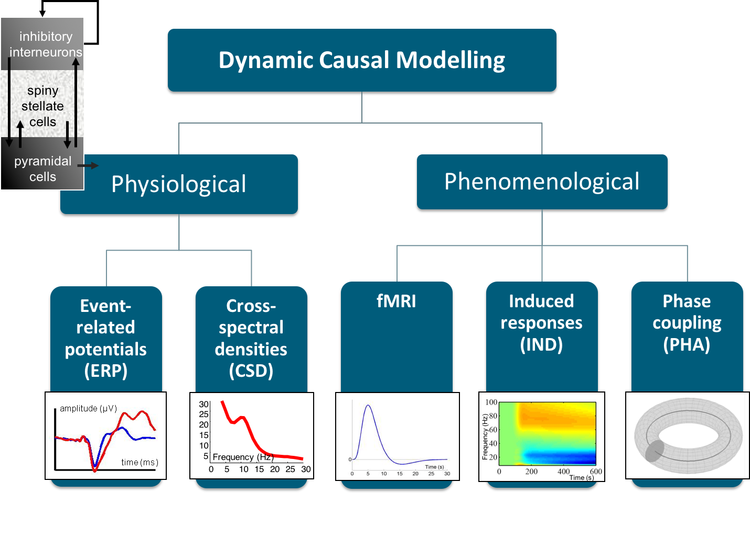

Slide 15
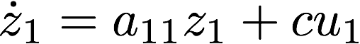
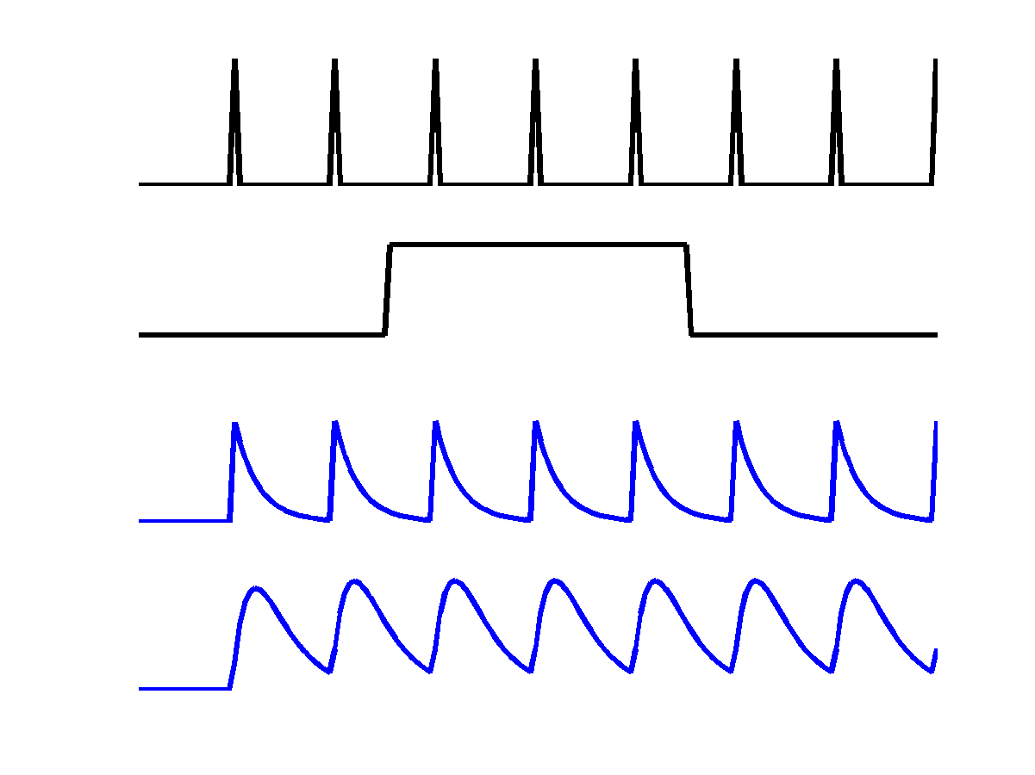
Single region
cf. Neural state equations in DCM for fMRI
u₁
c
u₁
a₁₁
z₁
u₂
z₁
z₂

Slide 16
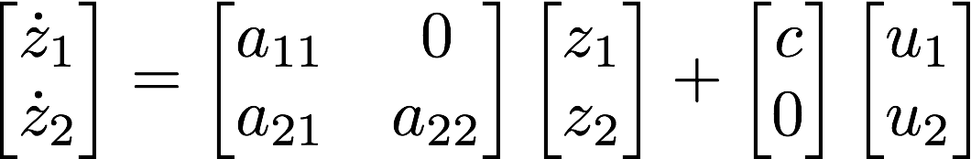
cf. DCM for fMRI
Multiple regions
u₁
c
u₁
a₁₁
z₁
u₂
z₁
a₂₁
z₂
z₂
a₂₂

Slide 17
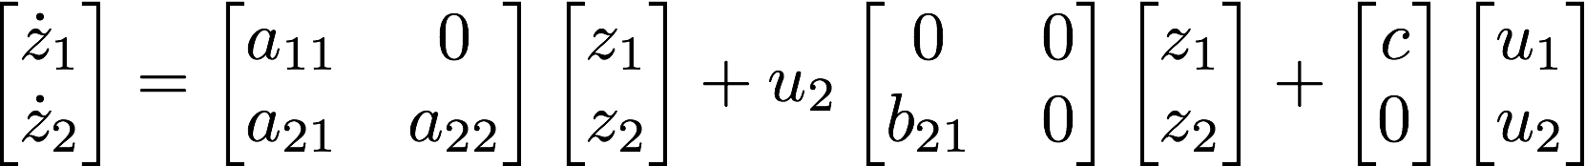
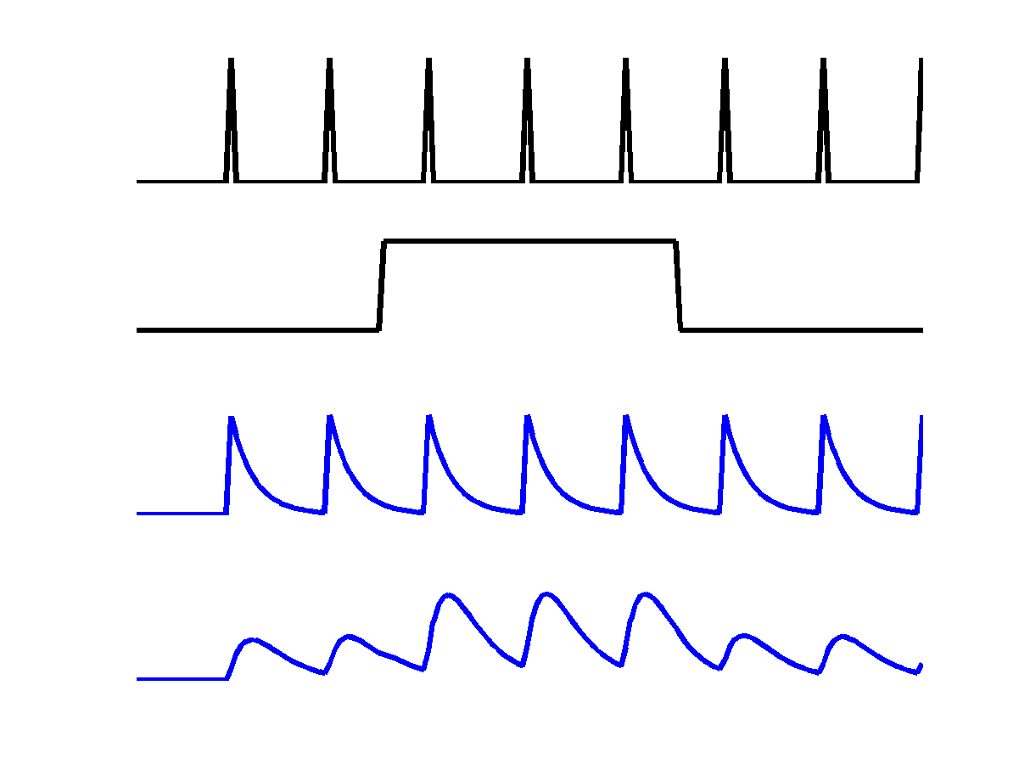
cf. DCM for fMRI
Modulatory inputs
u₁
u₂
c
u₁
a₁₁
z₁
u₂
b₂₁
z₁
a₂₁
z₂
z₂
a₂₂

Slide 18
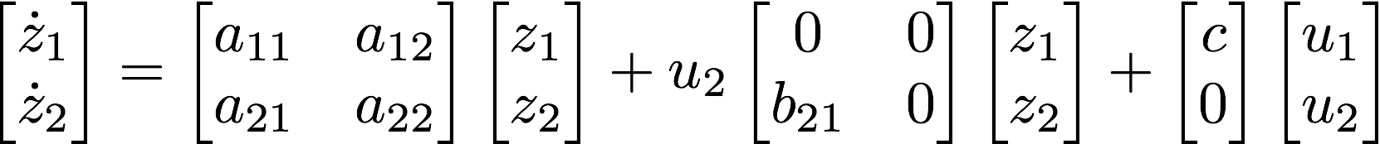
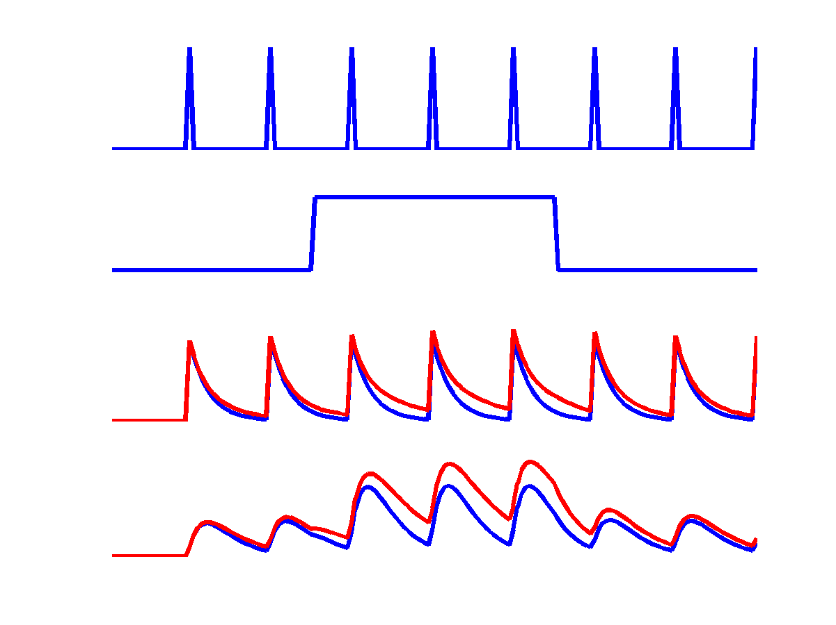
cf. DCM for fMRI
Reciprocal connections
u₁
u₂
c
u₁
a₁₁
z₁
u₂
a₁₂
b₂₁
z₁
a₂₁
z₂
z₂
a₂₂

Slide 20
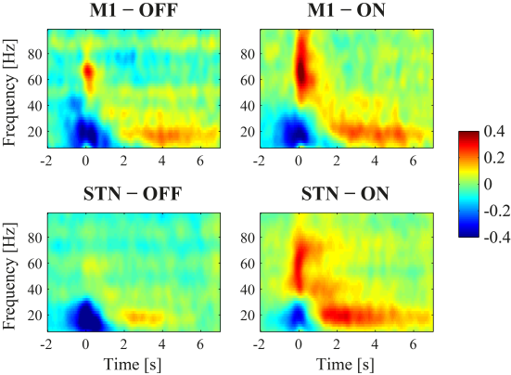

DCM for induced responses
Region 1
Region 2
?
?
Changes in power through external input and/or changes in power in other brain regions
Model comparisons Which regions are connected? E.g. Forward/backward connections
Parameter inference Does slow activity in one region affect fast activity in another?
(Cross-)frequency coupling

Slide 21
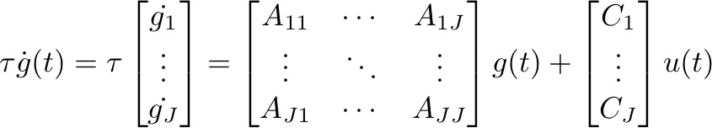
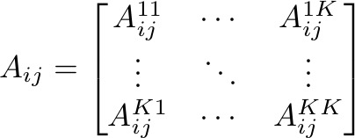
Generative Model
Intrinsic (within-source) coupling
Extrinsic (between-source) coupling
Linear (within-frequency) coupling
How frequency K in
region j affects
frequency 1 in region i
Nonlinear (between-frequency) coupling

Slide 22
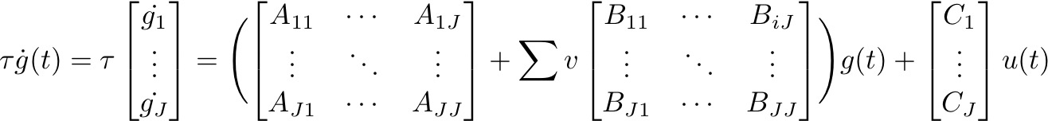
Modulatory connections
A matrix
B matrix
The B matrix is used to compare parameter values between conditions

Slide 23
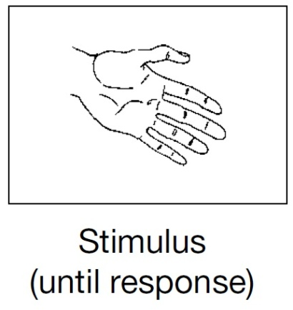
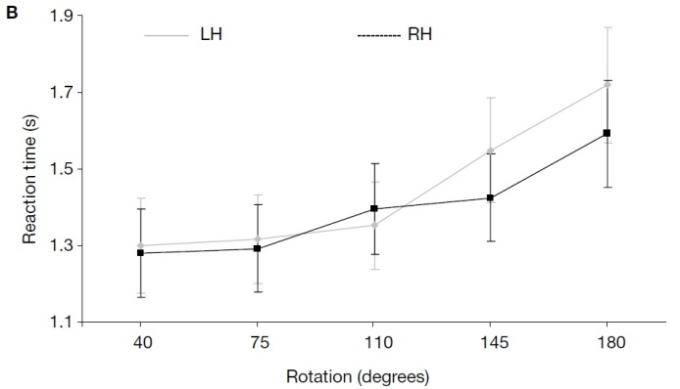
Example study with MEG data
Motor imagery through mental hand rotation
De Lange et al. 2008
van Wijk et al. 2012, Neuroimage

Slide 24
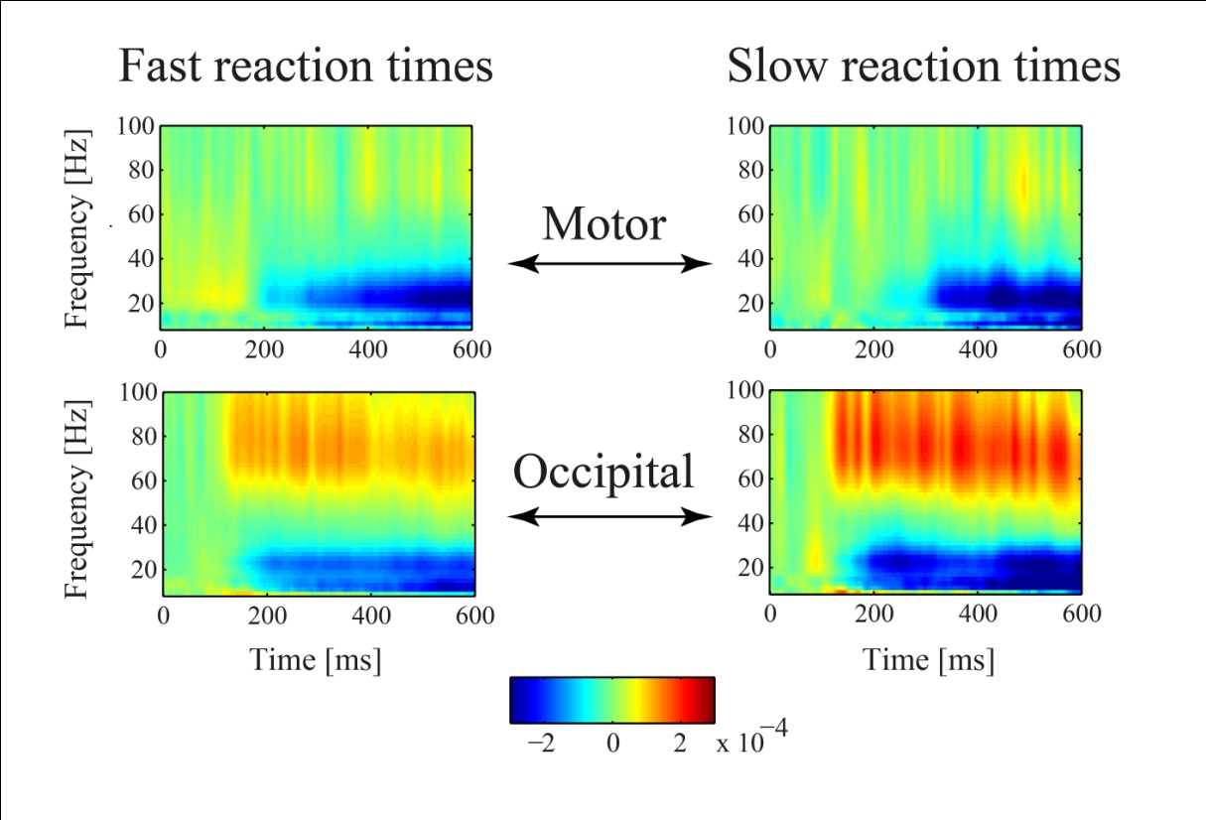
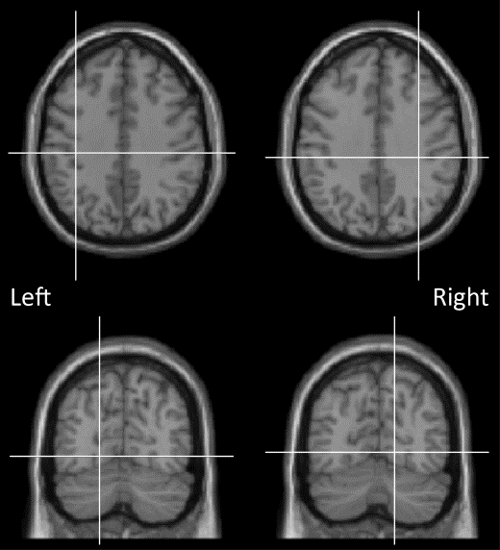
Induced responses in Motor and Occipital areas
M
O
MNI coordinates
[34 -28 37] [-37 -25 39]
[14 -69 -2] [-18 -71 -5]
Slow reaction times: Stronger increase in gamma power in O
Stronger decrease in beta power in O

Slide 25
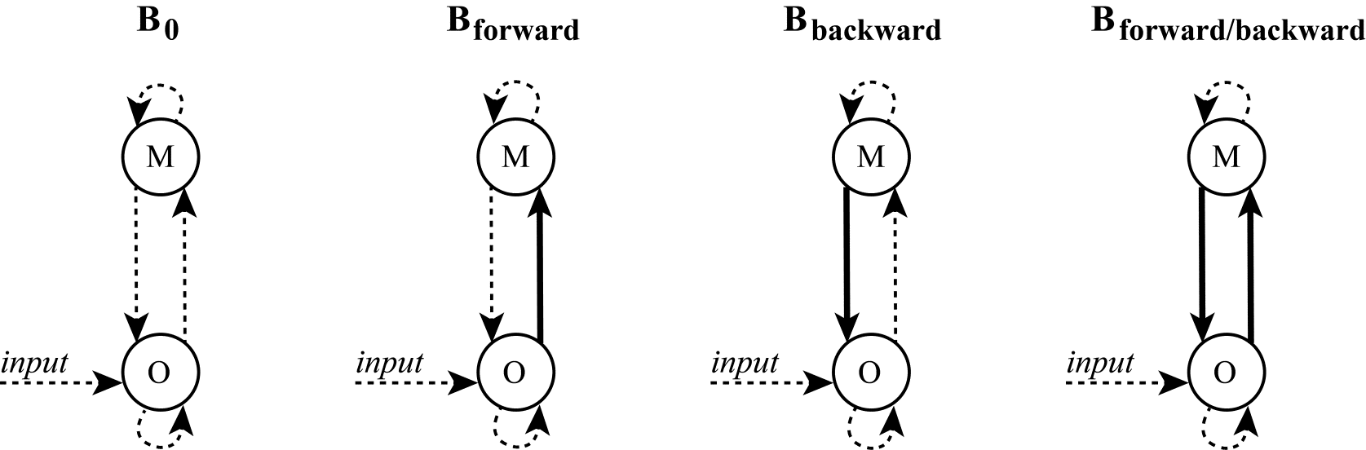
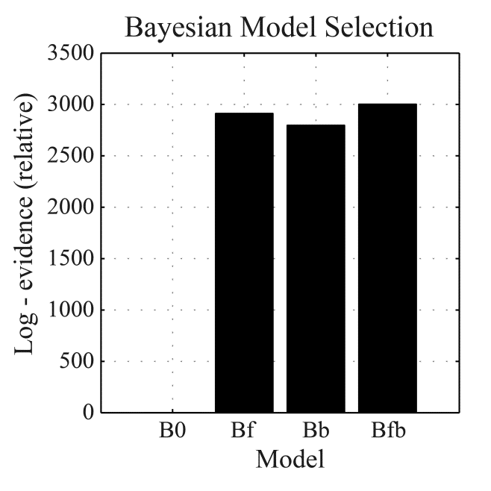
Model Comparisons
Do slow vs. fast reaction times differ in forward and/or backward processing?
A matrix = fast responses
B matrix = slow responses

Slide 26
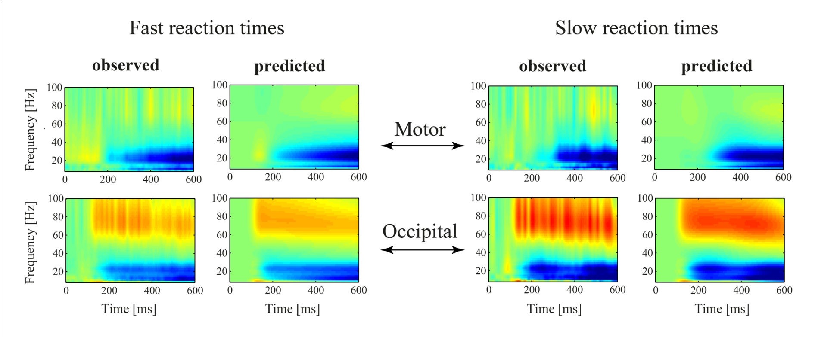
Results for Model B_{forward/backward}
Good correspondence between observed and predicted time-frequency spectra

Slide 27
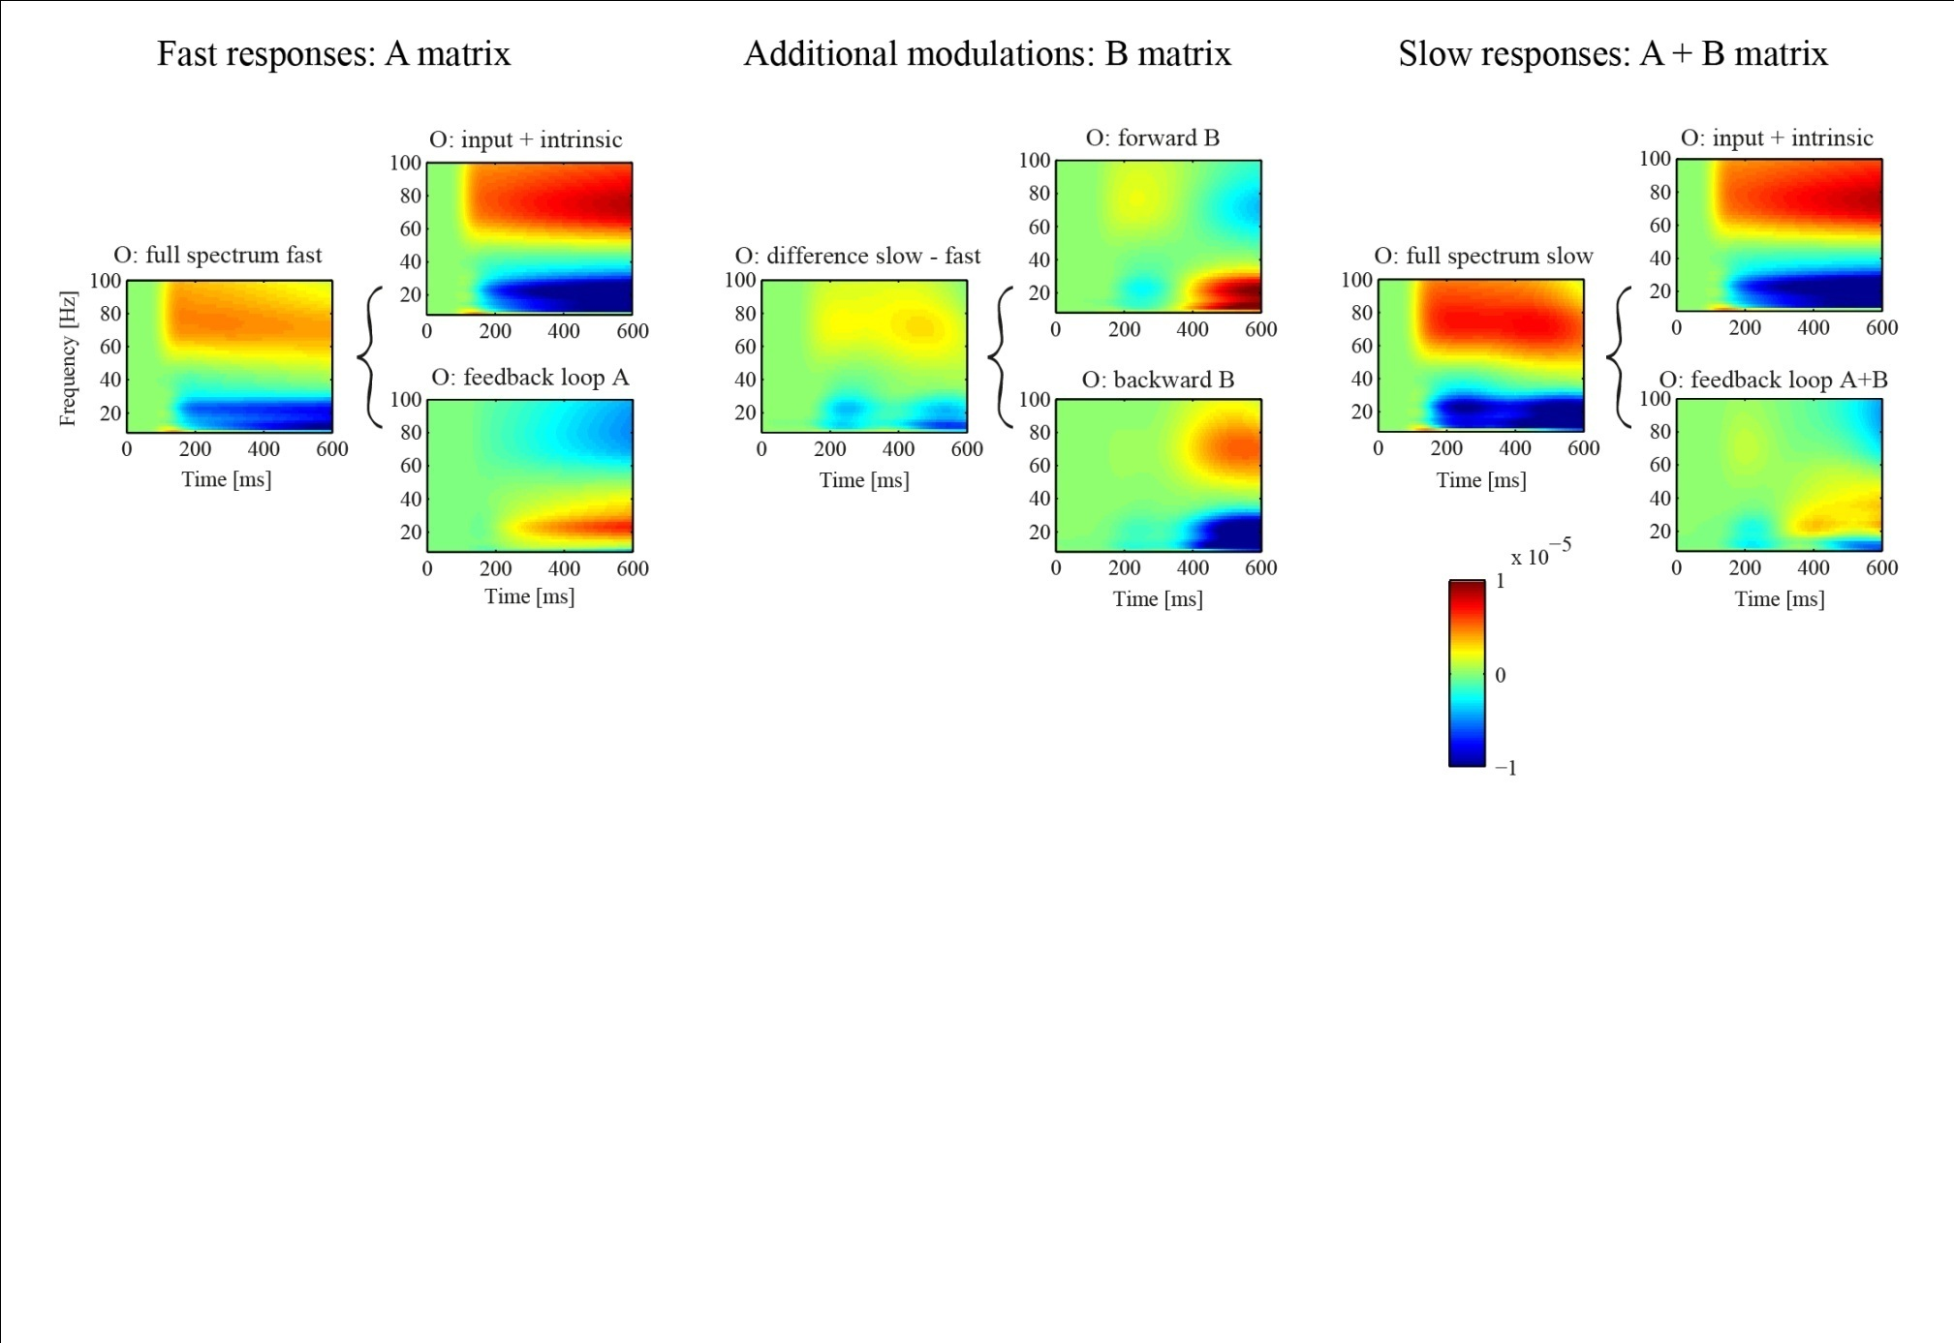
Simulations with estimated model parameters
Feedback loop with M acts to attenuate modulations in O
Attenuation is weaker for slow reaction times

Slide 28
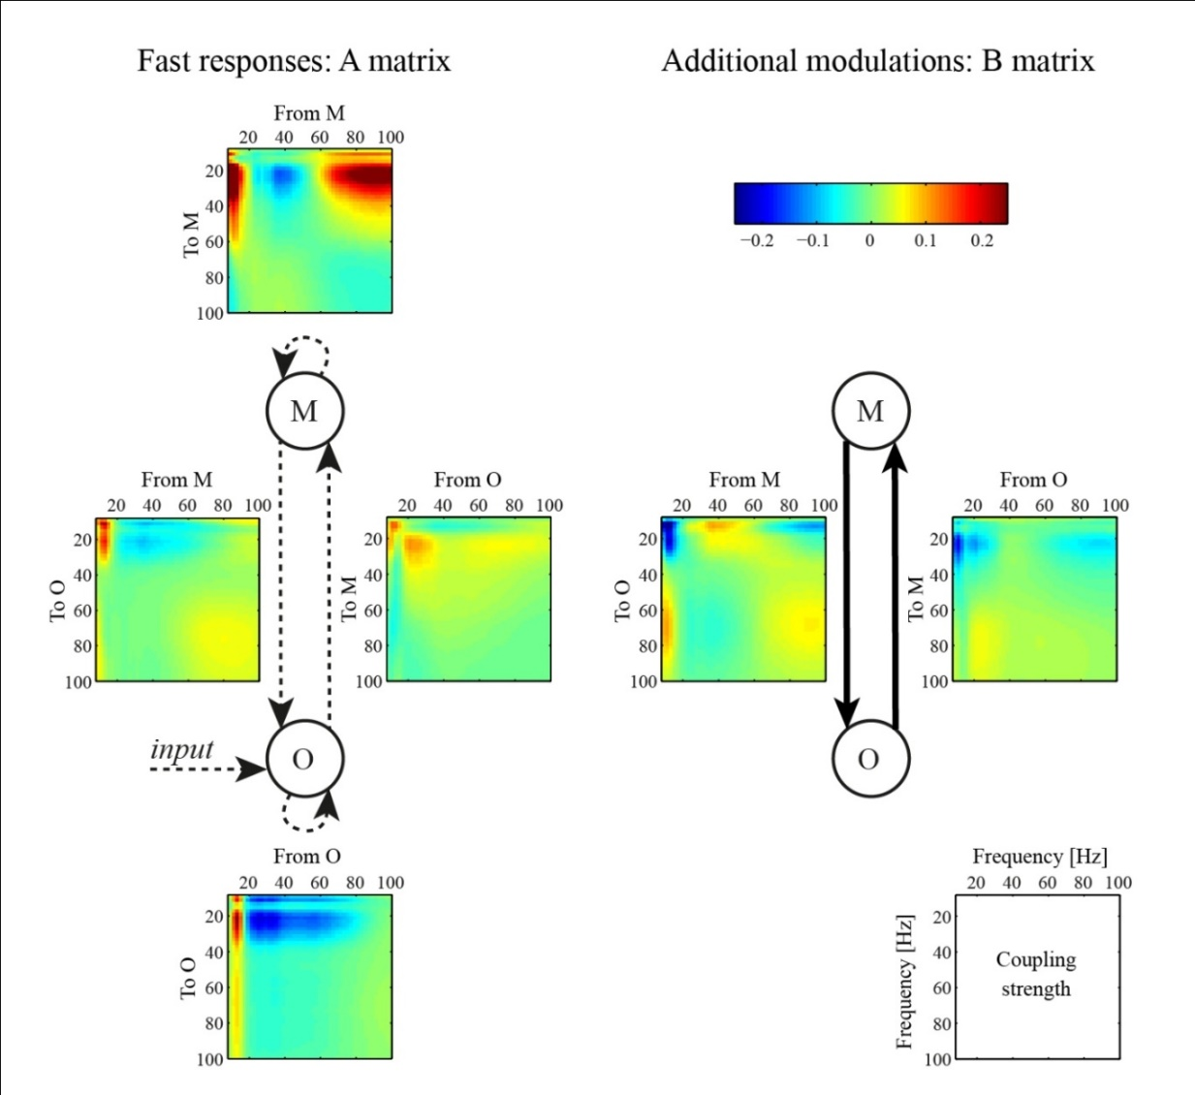
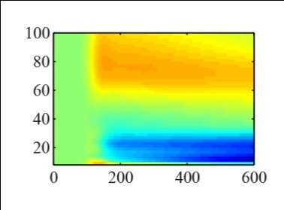
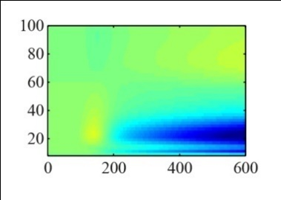
Parameter Inference
How does (cross-)frequency coupling lead to the observed time-frequency responses?
O
M
Interactions are mainly within frequency bands
Slow reaction times accompanied by a negative beta to gamma coupling from M to O

Slide 30
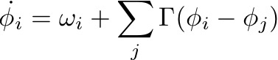
DCM for Phase Coupling
Region 1
Region 2
x~(t)
?
x~(t)
Phase
φ
?
x(t)
x(t)
Phase
φ
Synchronization through phase coupling between regions
Model comparisons Which regions are connected?
E.g. ‘master-slave’/mutual connections
Parameter inference (frequency-dependent) coupling values

Slide 32
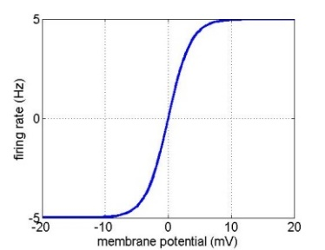
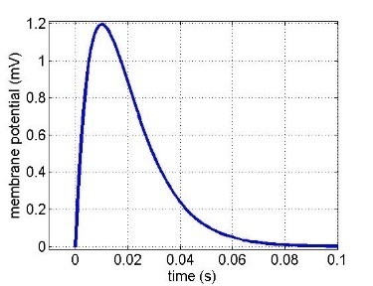
‘ERP’ model – Convolution based
Inhibitory cells in extragranular layers
Extrinsic input
Inhibitory interneurons
γ
γ
Exogeneous input
4
3
Spiny stellate cells
Excitatory spiny cells in granular layers
Extrinsic connections
Forward
Backward
Lateral
Extrinsic output
γ
Pyramidal cells
1
γ
Measured response
2
Excitatory pyramidal cells in extragranular layers
Sigmoid function
Synaptic kernel
H
Maximum
Post Synaptic Potential
Firing rate
Membrane potential
Inverse Time Constant
Membrane potential
Time (s)

Slide 33


Convolution models
Conductance models
Sigmoid function
Synaptic kernel
Current
Conductance
Reversal Pot – Potential Diff
H
Firing Variance
Firing rate
Membrane potential
Unit noise
Membrane potential
Time (s)
Time Constant
Afferent Firing
No. open channels
ERP original model - based on Jansen & Rit (1995)
SEP ERP with faster dynamics for evoked potentials
CMC Canonical Microcircuit Model (Bastos et al. 2012) separate superficial & deep pyramidal cells
LFP ERP with self-connection for inhibitory neurons (Moran et al. 2007)
NFM ERP as a neural field model
(Pinotsis et al. 2012)
NMM based on Morris & Lecar (1981)
MFM includes second order statistics (population density) (Marreiros et al. 2009)
CMM canonical neural mass / mean field model four populations
NMDA includes (ligand gated) NMDA receptors (Moran et al. 2011)
See: Moran et al. (2013) Frontiers in Computational Neuroscience
“Neural masses and fields in dynamic causal modeling”

Slide 34
Theoretical and Empirical Foundation
Long history of single neuron and population models
Hodgkin & Huxley, 1952; Wilson & Cowan 1973; Freeman et al. 1974; Jansen & Rit, 1995; Lopes da Silva et al., 1997; Morris & Lecar 1981; …
DCM validation via simulations
Friston et al., 2003; Moran et al., 2009; Moran et al., 2011; Friston et al., 2012; Chen et al., 2008; Penny et al., 2009; Pinotsis et al., 2012; …
DCM validation via pharmacological manipulations in rodents
Moran et al., 2011
DCM reproducibility in real data
Garrido et al., 2007; Litvak et al., 2015; …

Slide 35
Recent & ongoing developments
Improvements to inversion methods
E.g. Hierarchical modelling, Bayesian model reduction, Parametric empirical Bayes Friston et al. 2016
Model predictions of other data features
Phase-amplitude interactions - Fagerholm et al. 2020
Combination of EEG and fMRI recordings - Friston et al. 2016
Time-frequency modulations predicted by physiological models
…
New generative models
Variations of already implemented models
Non-cortical structures such as basal ganglia & thalamus - E.g. van Wijk et al. 2018

Slide 36
Generic DCM
‘Mix-and-Match’ of generative models
More flexible than standard implementation
Adding a new model is easy
van Wijk et al. 2018, Neuroimage

Slide 37


DCM of COVID-19
Friston et al. 2020 https://www.fil.ion.ucl.ac.uk/spm/covid-19/

Slide 38
Which DCM should I use?
0) What is your research question?
Select type of generative model
Physiological: convolution or conductance, several options
Phenomenological: fixed choice
Select data feature of interest
Event-related design: event-related potentials, induced responses
Steady state activity: cross-spectral densities, phase coupling
Specify networks - what do you want to test? (A matrix)
What is the hypothesis?
Which regions?
Which connections?
Think about condition-specific effects (B matrix)
Do you have more than 1 experimental condition?
Which connections may show a difference between conditions?

Slide 39

Some technical differences between DCM types
Physiological DCMs
Phenomenological DCMs
Model sensor level data
Inverse problem included
Optimize source locations
Test for how many sources
Model source level data
Take specified source locations
Cannot compare nr of sources
Model A
Model B

Slide 40
Some technical differences between DCM types
Physiological DCMs
Phenomenological DCMs
Model sensor level data
Inverse problem included
Optimize source locations
Test for how many sources
Model source level data
Take specified source locations
Cannot compare nr of sources
Event-related DCMs
Steady-state DCMs
External stimulus modelled with Gaussian impulse
Require baseline interval
Perturbation with white/pink noise to generate cross-spectra

Slide 41



In SPM
SPM GUI
SPM Batch
Matlab scripts

Slide 42
DCM uses computational models to link observed data features to their underlying (neurobiological) causes
Observed data features
Generative mechanisms
Generative model
“My ERP response is larger in condition A than in condition B.”
“My ERP response is larger because of stronger top-down connections.”

Slide 43
More examples
Video: DCM for evoked responses
Video: DCM for steady state responses
Video: DCM demo
SPM Manual
Previous publications

Slide 44
Further Reading
The original DCM paper | Friston et al. 2003, NeuroImage
Guide to MEG/EEG analysis in SPM | Litvak et al. (2011) Comput Intell & Neurosci
Descriptive / Tutorial papers
Ten Simple Rules for DCM | Stephan et al. 2010, NeuroImage
Overview of generative models | Moran et al. 2013, Front Comput Neurosci
Model selection for group studies | Stephan et al. 2009, Neuroimage
Comparing families of DCMs | Penny et al. 2010, PLoS One
DCM applications
Event-related potentials | David et al. 2006, Neuroimage Garrido et al. 2007, PNAS Boly et al. 2011, Science Auksztulewicz & Friston, 2015, Cerebral Cortex
Cross-spectral densities | Moran et al. 2009, Neuroimage Moran et al. 2011, PLoS One Friston et al. 2012, Neuroimage
Induced responses | Chen et al. 2008, 2009, Neuroimage Van Wijk et al. 2012, Neuroimage
Phase coupling | Penny et al. 2009, J Neurosci Methods

